Slide 1
AR Drone
On-Board Marker Detection and Following using AR-Drone

Slide 2
Group Members:
Name | Roll Number
Muhammad Hassan Nadeem | 2015-10-0063
Danial Nawaz | 2015-10-0177

Slide 3



Postgraduate Students
Undergraduate Students
Final Year Project
Microeconomics
Network Security
Audio Video
Mobile Robotics
Mobile Robotics
Embedded Systems
Embedded Systems

Slide 4
Mathematical Analysis
Postgraduates have 3*2 = 6 credit hours worth of course work.
Undergraduates have 3*6 = 18 credit hours worth of course work.
Simple Mathematical analysis:
Undergraduates have 18/6 = 3 times the course load.
Conclusion:
For equal quality of work, Undergraduates should get 3 times the grade points compared to Postgraduates.

Slide 5
Cross-Compilation
Porting OpenCV 2.4.10 to AR Drone 2.0

Slide 6
OpenCV in AR Drone
Nightmare to port OpenCV to AR Drone.
Numerous Problems in
Setting up cross compilation environment
Linking shared libraries
FFmpeg support
etc. etc.
Every thing is documented and available on my Blog : blog.HassanNadeem.com

Slide 7
Capturing Video Stream

Slide 8
Video Stream
Front Camera is 720p (1280x720) , 30 FPS.
AR Drone sends TCP stream of Video on PORT 5555 encoded in either MPEG or H264.
We use FFMPEG libraries with x264 to decode the stream for OpenCV.
Drone configured to stream 360p video at 15 FPS.

Slide 9
AR Drone API
AT Commands

Slide 10
AT Commands
AR Drone can receive AT commands on UDP port 5556.
AT commands are strings encoded as 8-bit ASCII characters.
You can pass integer, float and string arguments with AT commands.
Integers are encoded as strings with their decimal representation.
32-bit Floating point numbers are encoded as 32-bit integers.
Example AT Command to move drone forward with 50 % velocity:
AT*PCMD=63,1,0, 1056964608,0,0

Slide 11
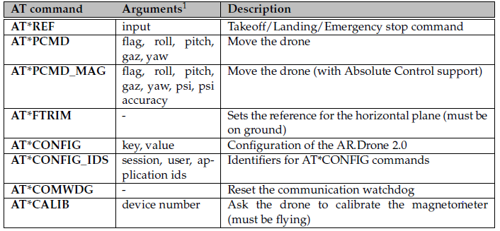
AT Commands Summary
List of Available AT-Commands:

Slide 12
AT*PCMD
Send progressive commands - makes the drone move (translate/rotate).
Argument 1 : the sequence number
Argument 2 : flag enabling the use of progressive commands and/or the Combined
Yaw mode (bitfield)
Argument 3 : drone left-right tilt - floating-point value in range [-1 to 1]
Argument 4 : drone front-back tilt - floating-point value in range [-1 to 1]
Argument 5 : drone vertical speed - floating-point value in range [-1 to 1]
Argument 6 : drone angular speed - floating-point value in range [-1 to 1]

Slide 13
Navigation Data

Slide 14
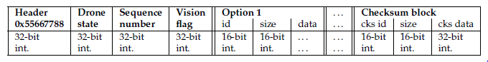
What is Navigation Data?
Information containing drone status, roll, pitch, yaw, altitude, x,y,z velocities etc.
Sent periodically every 5ms.
Encoded data sent over UDP port 5554 in binary format.

Slide 15
Extracting Navigation Data
A dedicated thread running that
Requests
Receives
Decodes and
Publishes
Navigation Data.

Slide 16
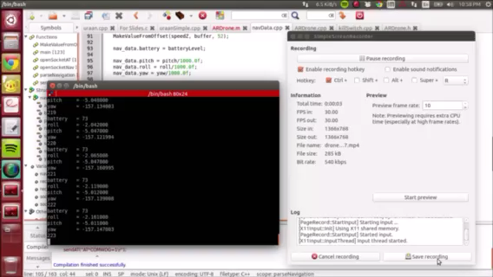


Nav_Data Demo
ROLL
PITCH
YAW

Slide 17
How are we using Navigation Data?
We are not!
The velocity commands given to the Drone are in percentages of maximum inclination.
We planned to use Navigation Data to close the loop on velocity commands.
So that linear and angular velocities can be specified in m/s and rad/sec.
Not able to do so due to lack of time. (See Slide # 3)

Slide 18
Multiple Threads
And Boost Libraries

Slide 19
Multi-threaded Application
AR-Drone requires velocity commands to be published every 30ms for smooth movements.
AR-Drone publishes Navigation Data every 5ms.
Decoding and processing an image takes over 500ms.
Need for multithreading for a smooth ride.

Slide 20
Boost Libraries
We have used Boost libraries for threading.
Boost is a set of libraries for the C++ programming language that provide support for tasks and structures such as linear algebra,pseudorandom number generation, multithreading, image processing, regular expressions, and unit testing.
Becoming de facto standard.
Abstracts hardware.
Easy to learn and Boosts productivity.
Fully cross-platform – Very easy to cross-compile.

Slide 21
Marker Detection

Slide 22
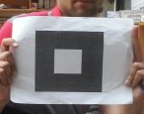
Creating Marker
Ready-made marker and QR-Code detection libraries too intensive for AR Drone processor.
Need for a simple marker that is easy to detect with low false positives.
So we created our own marker.
A square within a square.
And wrote code to detect that marker.

Slide 23
Creating Marker: Big Picture
Canny Edge Detection
Find Contours
Grayscale
Find Squares
Identify Marker
Image

Slide 24
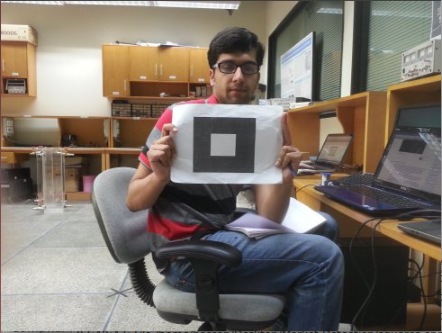
Marker Detection Process
Original Image

Slide 25
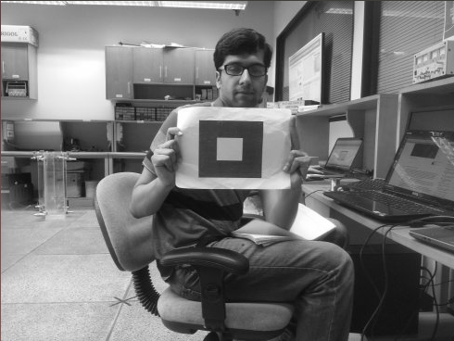
Marker Detection Process
Grayscale

Slide 26
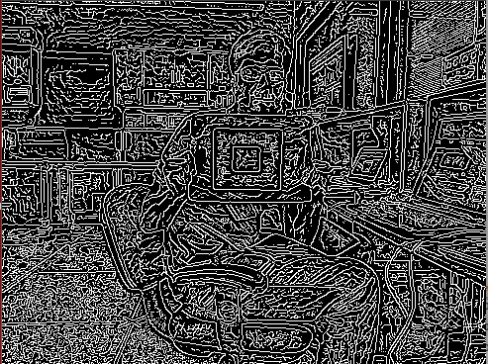
Marker Detection Process
Canny Edge Detection

Slide 27
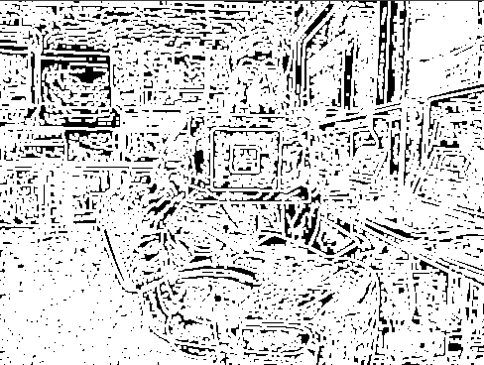
Marker Detection Process
Dilation

Slide 28
Marker Detection Process
Find all contours in a given image
Find all contours in the given image
Approximate
approximate bad shapes to the closest matching shape
Find Squares
apply conditions to find shapes with 4 edges and angle in specific range
Square filtering
filter squares to our specific condition

Slide 29
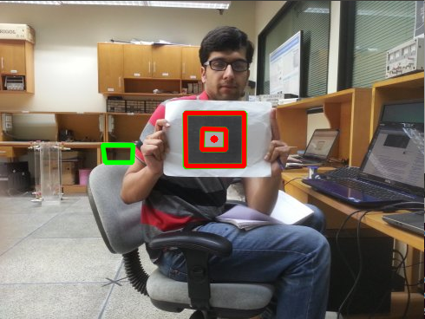
Marker Detection Process
Find center of image using moments
Draw center of image and square to display window

Slide 30
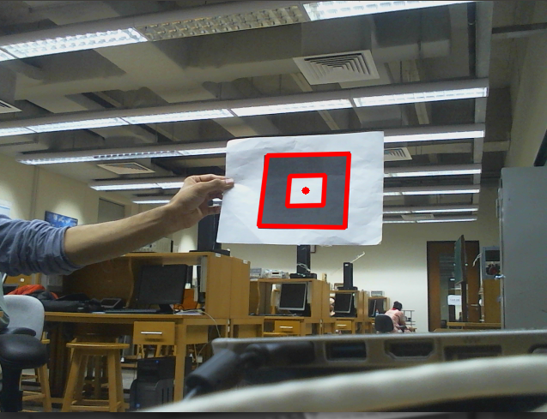
Robustness

Slide 31
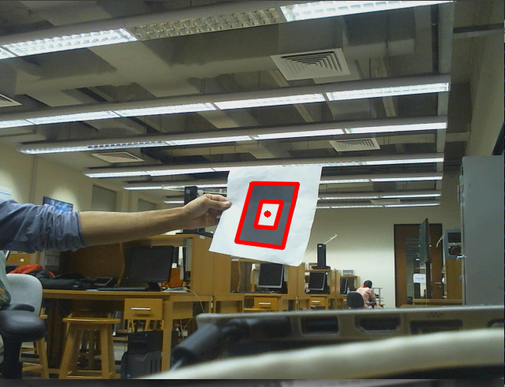
Robustness

Slide 32
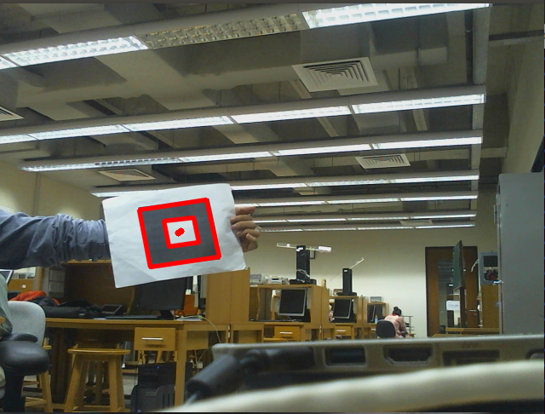
Robustness

Slide 33
Demo

Slide 34
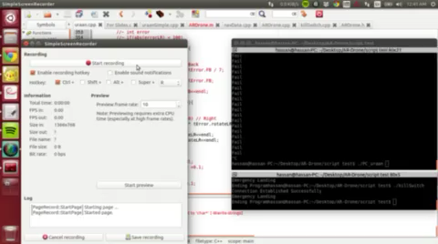
Left Right

Slide 35
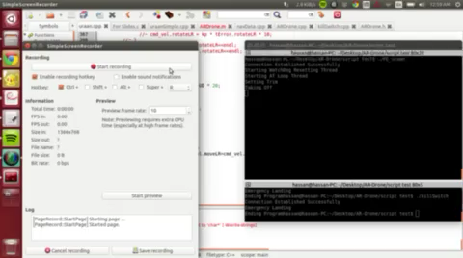
Up Down

Slide 36
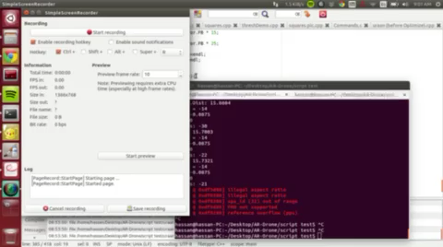
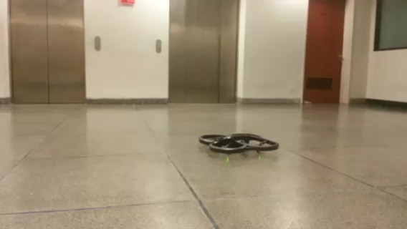
Demo 2

Slide 37
Conclusion

Slide 38
What have we achieved?
Definition of Drone:
An unmanned aircraft or ship that can navigate autonomously, without human control or beyond line of sight.
AR Drone is now truly a Drone.
Can be used beyond line of sight.
Truly autonomous.

Slide 39
Problem?

